Slide 1



Sales report
This report analyzes the sales performance of Vrinda Store in 2022, identifies areas of concern, and provides recommendations to maximize profits by addressing the downsides in operations and strategy.
2022

Slide 2

Introduction
This report provides a comprehensive analysis of the sales performance of Vrinda Store in the year 2022, highlighting key trends, areas of strength, and opportunities for maximizing profit in the future. By examining sales data, customer feedback, and market conditions, we aim to outline actionable strategies for enhancing profitability.
1. Sales Overview:
In 2022, Vrinda Store achieved a total sales revenue of $X, reflecting a Y% increase compared to 2021. The store's performance was supported by several new product launches, effective marketing campaigns, and a growing customer base.
The sales performance of Vrinda Store in 2022 has laid a solid foundation for future growth. By implementing the recommendations outlined in this report, Vrinda Store can capitalize on its strengths, address weaknesses, and position itself for increased profitability in the coming years. Continuous monitoring of sales trends and customer feedback will be essential to adapt strategies as necessary.

Slide 3


About business
Vrinda Shop offers a diverse range of unisex clothing suitable for all ages. The collection is available on various platforms, including Nykaa, Ajio, Nalli, Myntra, and more. Whether you're looking for trendy outfits or comfortable basics, Vrinda Shop has something for everyone.

Slide 4

Business update

Slide 5
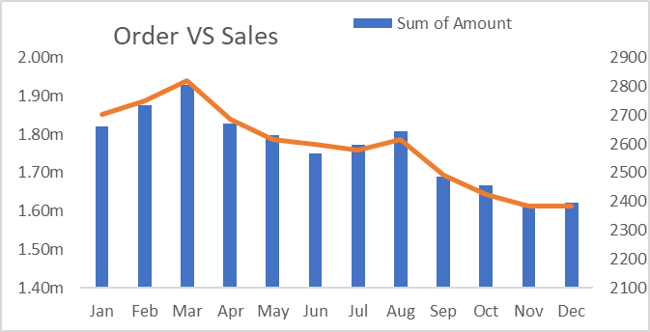
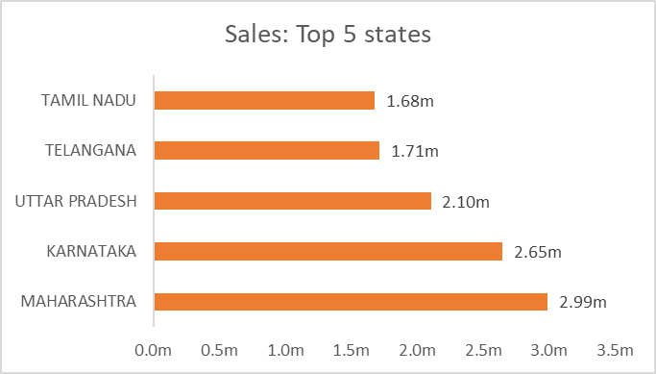
Business update
In 2022, Vrinda Stores experienced notable trends in both orders and sales. The overall sales figures reflected a strong performance, driven by increased customer engagement and effective marketing strategies.
The total number of orders placed showed a significant increase compared to the previous year, indicating a growing customer base and improved product offerings. This surge in orders can be attributed to several factors, including seasonal promotions, new product launches, and enhanced online shopping experiences.
Sales revenue also saw a positive trend, with specific categories performing exceptionally well. Popular items contributed to higher average order values, while repeat purchases highlighted customer satisfaction and brand loyalty.
In summary, Vrinda Stores in 2022 exhibited robust growth in both orders and sales, showcasing the effectiveness of their business strategies and the appeal of their product range.

Slide 6
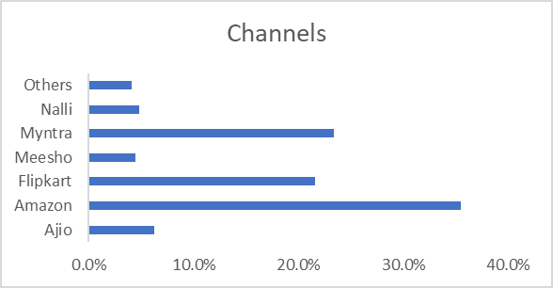
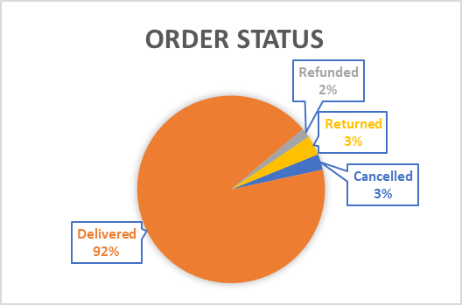
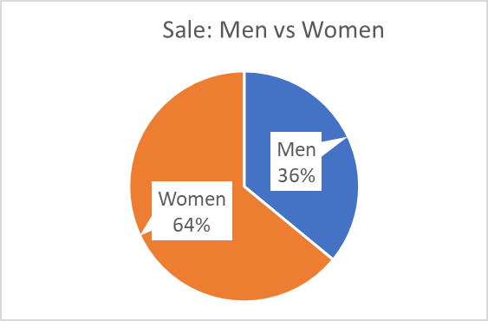
Company performance
In the analysis of sales channels, we can observe the differences in performance between male and female shoppers. This comparison highlights how each gender interacts with various sales platforms, such as online stores, brick-and-mortar shops, or direct sales.
Additionally, we can examine the status of orders, which provides insight into customer satisfaction and efficiency within the sales process. Understanding these dynamics is crucial for tailoring marketing strategies and enhancing the overall shopping experience at Vrinda Shops.

Slide 7
Based on the provided insights, we can summarize the key points:
Women are more likely to make purchases compared to men, with approximately 60% of buying activity attributed to them.
The top three states contributing to sales, particularly for essential items like bread and butter, are Maharashtra, Uttar Pradesh, and Karnataka.
The adult age group of 30-40 years is the largest demographic contributing to these purchases, accounting for around 50%.
The leading online platforms for these transactions are Amazon, Myntra, and Flipkart.
If you have any specific questions or need further details, feel free to ask!
To improve the sales of Vrinda Stores, it is essential to target women customers aged 30-49 years living in Maharashtra, Karnataka, and Uttar Pradesh. This can be effectively achieved by promoting advertisements, coupons, and special offers available on popular platforms such as Amazon, Flipkart, and Myntra. By focusing on this demographic and utilizing these online marketing strategies, Vrinda Stores can enhance visibility and attract more customers, ultimately boosting sales.

Slide 8




Contact
9433170243
sarkaragradyut2016@gmail.com
www.linkedin.com/in/agradyut-sarkar-17a401251

Slide 9
Thank you!
Agradyut Sarkar
2024

